Slide 1
Day 6: JOINS (INNER, LEFT, RIGHT, FULL)
Inner Join
Left Join
Right Join
Self Join
Full outer Join
Cross Join

Slide 2
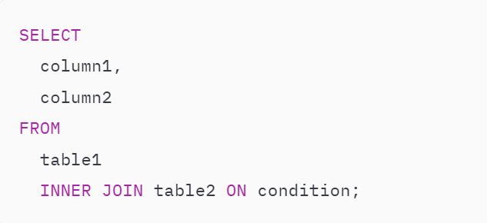
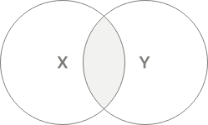
INNER JOIN clause
Allows you to merge rows from two related tables.
Typically, the condition compares values between two columns of the two tables for equality:

Slide 3
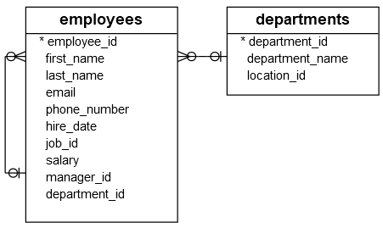

Slide 4
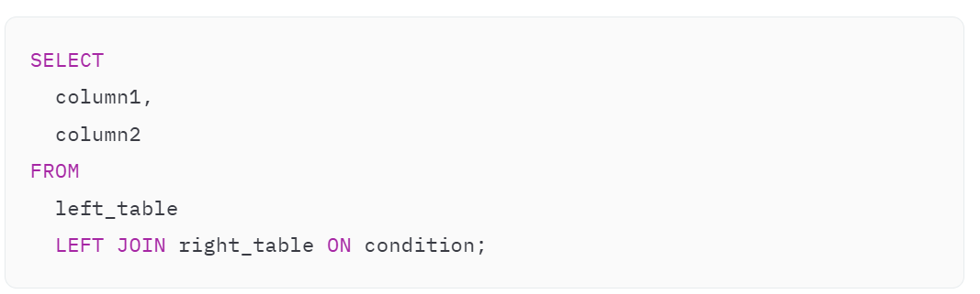
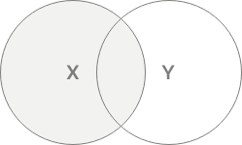
LEFT JOIN clause
always includes all rows from the left table.
LEFT JOIN clause matches every row from the left table (left_table) with every row from the right table (right_table) based on the condition.
The LEFT JOIN and LEFT OUTER JOIN are the same because the OUTER keyword is optional.

Slide 5
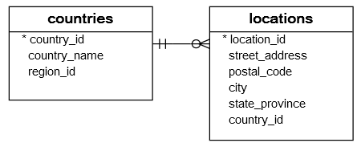

Slide 6
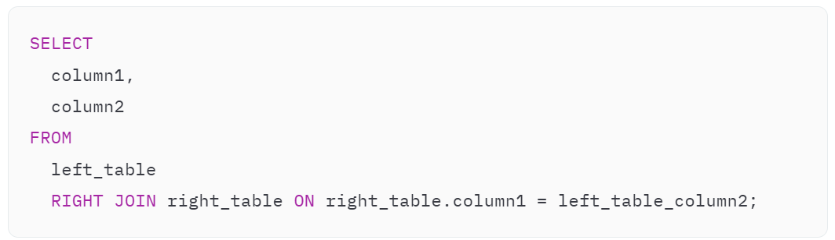
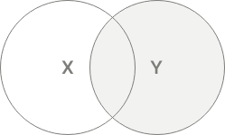
RIGHT JOIN clause
always includes rows from the right table.
RIGHT JOIN checks the condition with each row in the left_table. If the condition is true, the RIGHT JOIN merges two rows from both tables into a single row.
RIGHT JOIN and RIGHT OUTER JOIN are the same

Slide 8
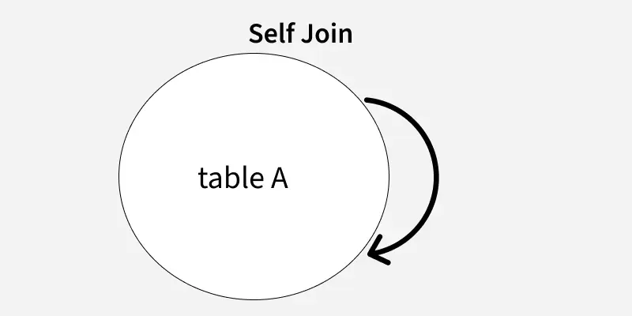
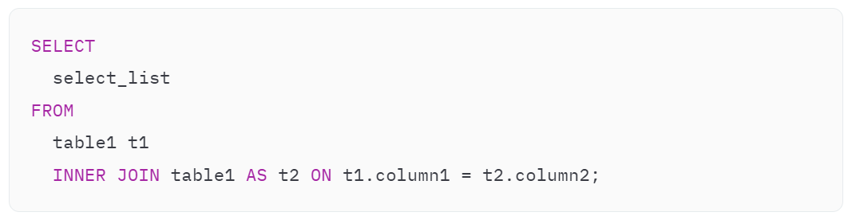
self-join
You can use a join to compare rows within the same table. In this case, you join a table to itself that forms a self-join.
It uses table aliases to treat the same table as separate tables within the same query.

Slide 9
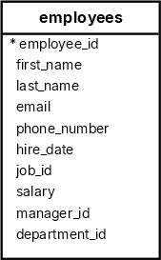

Slide 10
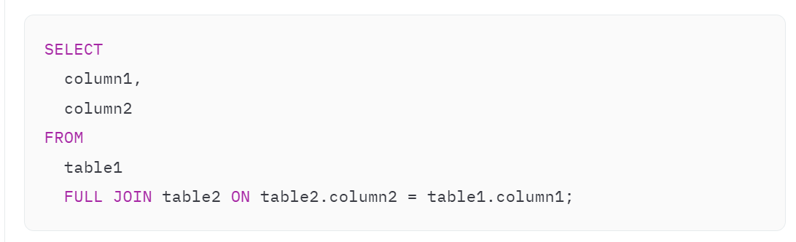
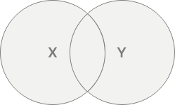
FULL OUTER JOIN clause
clause combines rows from both tables into a single row and includes it in the result set.
a FULL OUTER JOIN is a combination of a LEFT JOIN and a RIGHT JOIN
The OUTER keyword is optional, you can omit it in the query.

Slide 11
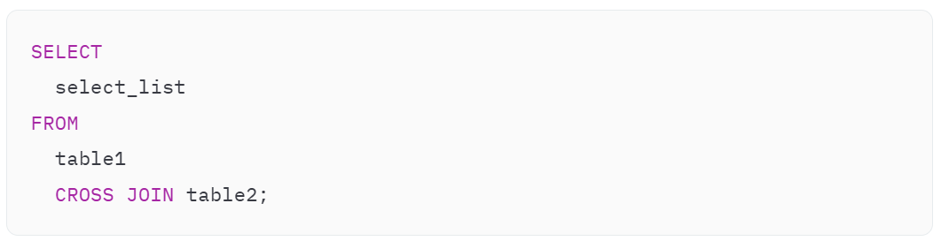
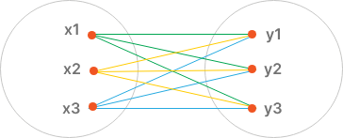
CROSS JOIN clause
allows you to create combinations of all rows from two tables.
The result set of a CROSS JOIN is often called the Cartesian product of two tables.
If the table1 has n rows and table2 has m rows, the CROSS JOIN will return a result set that includes n * m rows.

